Slide 1
Digital Portfolio
STUDENT NAME: BUVANA.G
REGISTER NO AND NMID: 24132161802522022
DEPARTMENT: B.Sc Computer Science
COLLEGE: COLLEGE/ UNIVERSITY Govt arts and science college

Slide 2
PROJECT TITLE
Drawing app

Slide 3


AGENDA
Problem Statement
Project Overview
End Users
Tools and Technologies
Portfolio design and Layout
Features and Functionality
Results and Screenshots
Conclusion
Github Link
3/21/2024 Annual Review

Slide 4

PROBLEM STATEMENT
Many people need a simple digital space to sketch, doodle, or take visual notes.Existing drawing apps can be too heavy or require installation.Goal: Build a lightweight, browser-based drawing app using only web technologies.

Slide 5
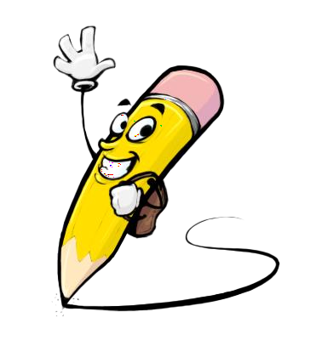
PROJECT OVERVIEW
A web-based drawing tool built with HTML, CSS, and JavaScript.Provides a canvas where users can draw with mouse or touch.No downloads needed—runs directly in the browser.

Slide 6

WHO ARE THE END USERS?
Students (for sketches, diagrams, notes).Designers/Artists (for quick doodles).General users (for fun drawings or creative practice).

Slide 7

TOOLS AND TECHNIQUES
HTML5 Canvas → drawing surface.CSS → layout, design, and styling of buttons/tools.JavaScript → drawing logic (brush strokes, colors, erase, clear).Event handling for mouse and touch inputs.

Slide 8
POTFOLIO DESIGN AND LAYOUT
Clean and minimal interface.Toolbar at the top/bottom (color picker, brush size, eraser, clear button).Large canvas area for drawing.Responsive design (works on both desktop and mobile).
8

Slide 9
FEATURES AND FUNCTIONALITY
Draw using mouse or touch.Choose different brush colors.Adjust brush thickness.Erase part of the drawing.Clear entire canvas with one click.

Slide 10

RESULTS AND SCREENSHOTS
Fully working drawing app.Tested on multiple browsers and devices.Allows smooth drawing with both mouse and touchscreen.[Insert screenshot of your drawing app here].
3/21/2024 Annual Review
10

Slide 11
CONCLUSION
Successfully created a simple drawing app with core web technologies.Helps users express creativity without installing any software.Future improvements: save drawings as images, add shapes/text tools, add undo/redo functionality.
11

